Slide 1
Risk Analytics (RA)
March, 2018

Slide 2
Risk Analytics (RA)
Risk Analytics: Is the study of the underlying uncertainty of a given course of action. ... By using analytics to measure, quantify, and predict risk, leaders can rely less on intuition and create a consistent methodology steeped in data-driven insights
Risk analysts examine a firm's investment portfolios, including overseas investments, and analyze the risk involved in associated decisions. They use their analytical skills to project potential losses, and make recommendations to limit risk through diversification, currency exchanges and other investment strategies.
Regularory:
Risk control Dodd Frank Act, Basel1
Risk Analysis Tool

Slide 3
Risk Analytics (RA)
Risk:
Uncertainty of outcome
It is the threat or probability that an action or event, will adversely or beneficially affect an organization's ability to achieve its objectives.
Risk = X (Probability of event occurring)
(Impact of event occurring)
Risk Management: Risk Management is the Identification, Analysis and Economic Control of those risks which can threaten the Assets (Property, Human) or the earning Capacity of an Enterprise.
Objective:
To bring the overall and specific risk level at an acceptable level at minimum possible cost.
Analysis of Risk:
Stages in the analysis of risk:
Find the source of the Risk
Nature of Assets/ Liabilities getting affected
Quantification of loss

Slide 4
Risk Analytics (RA)
Types of Risks:
Operational Risk
Credit Risk
Market Risk
Business Event Risk
Inflation Risk
Investment Risk
Liquidity Risk
Political Risk
Reinvestment Risk

Slide 5
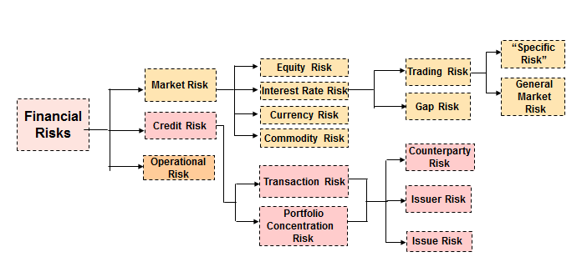
Corporate and Institutional Banking ( C & IB)
Major Financial Risks
Market Risk
Financial
Risks
Credit Risk
Operational Risk
Hierarchy of Financial Risks

Slide 6
Corporate and Institutional Banking ( C & IB)
Credit Risk:
When there is a counterparty failure in performing the repayment obligation on due date, it gives rise to credit risk.
Credit risk is inherent part of any firm that is into business of lending funds.
Market Risk:
Market risk is the risk of value of a firm’s investment going down as a result of market movement. It is also referred as price risk or systematic risk.
Market risk cannot be distinctly separate from other risk. It results from interplay of other risks.
Interest rate risk and exchange rate risk contribute the most to the presence of marker risk
.
Identification | Late and irregular payments, Reduction in payment amount
Control | Exhaustive scrutiny procedures, Aggressive collection mechanism

Slide 7
Corporate and Institutional Banking ( C & IB)
Operational Risk:
This risk results from inadequate or failed internal processes/people/systems or from external events.
Operational risk can be summarized as human risk; it is the risk of business operations failing due to human error. Operational risk will change from industry to industry, and is an important consideration to make when looking at potential investment decisions. Industries with lower human interaction are likely to have lower operational risk
Identification | Vulnerable Systems, human error
Control | Adopting standardized practices, Training

Slide 8
Corporate and Institutional Banking ( C & IB)

Slide 9
Corporate and Institutional Banking ( C & IB)
Tools used for Risk Analysis: Institutional Banking is a specialized division within a bank that offers a

Slide 10
Corporate and Institutional Banking ( C & IB)
Risk Management:
Risk Ratings:
Regulatory Reporting:
GL: General Ledger
Off Balance Sheet:
CIF Code:
Start Date:
Maturity Date:

Slide 11
Corporate and Institutional Banking ( C & IB)
Interest Rate:
Liquidity Coverage Ratio (LCR):
Counterparty:
Regulatory :
Lending:
Borrow:
Instrument Type:
Instrument Level:
Credit Rating:
Credit Loss:

Slide 12
Corporate and Institutional Banking ( C & IB)

Slide 13
Corporate and Institutional Banking ( C & IB)

